Slide 1
Polyamory and Identity
Leanna Wolfe, Ph.D.
Presented to PolyLiving 2010
February 20, 2010
Philadelphia, PA

Slide 2
Poly Identities
Public–Degrees of Disclosure
  Friends
  Facebook
  Family
  Workplace
  Mass Media
Private
  Primary Partner
  Favoritism

Slide 3
Definitions of Polyamory
Responsible/ethical/honest non-monogamy
Having sex with more than one man/woman
A deep, emotional, sometimes physical relationship with more than one partner simultaneously
Relationship with multiple people in which everyone knows about each other and is okay about it.
Having multiple concurrent romantic relationships with the full informed, uncoerced consent of all parties.

Slide 4
More Definitions…
Believing that we can love more than one person at the same time, with or without sexual engagement.
An exploration into conscious relating that doesn't subscribe to the conventional paradigm of lifelong marriage. Rather than revolving around the couple, it revolves around the individual as a whole and evolving person. Based on non-possessive love.

Slide 5
Poly Cultural Conventions
Embrace Poly Culture
Jealousy Management
Compersion
NRE Management
Disclosure
  Transparency
  Consensuality

Slide 6
The Hallmark of Polyamory
Appetite for Disclosure
  Open to Hear
  Open to Share
  Safety in Knowing
Compersion
  Positive Regard for Partners’ Extra-Relationship Erotic/Emotional Connections

Slide 7
Compersion Comments
It varies: sometimes I'm genuinely happy for them (both), sometimes I have to force myself to be realistic so as to not feel jealous. Sometimes I'm openly jealous and sometimes I feel indifferent.
It depends on whether I've met and liked the other person. My boyfriend tends to chose poorly for himself, so I'm suspicious until I meet this new person. My husband has no other partners.

Slide 8
More on Compersion…
It's complicated. :-) I am happy that my partner had a great time. But that doesn't mean that hearing all of the details is particularly easy.
Sometimes I do and sometimes I don't. Usually depends on where I am with my own insecurities.

Slide 9
Polyarmory
Agreements to ensure one’s own status and security in a relationship
  Partner Approval (e.g. someone who does not have a monogamy agenda)
  Scheduled Visits (e.g. no secret rendezvous)
  Approved Activities (e.g. safe sex)
  No Surprises

Slide 10
The Real Poly Lessons
Boundaries
  Respect partners’ needs to be connected to others
  High intensity communication
Dark Night of the Soul Journey
  Learning to be alone
  Self-nurturing
  Positive self identity independent from presence/absence of lovers/partners
  Release the desire to control others

Slide 11
Jealousy and Polygyny
(African Research)
Occurs when resources can be divided unevenly
Can happen when visiting times are unequal
Can arise when favoritism is suspected
Can occur when it is not chosen by the wives
  switching from monogamy to polygyny
  co-wives that don’t get along

Slide 12
Favoritism
Whoever is New is Typically Favorite
  The Brain Chemistry of NRE
    High Dopamine
    High Norepinephrine
How it’s Managed in Africa
  Every wife has a status
How Polygamous FLDS Mormons Manage It
  Wives will marry into a new marriage to become the favorite

Slide 13
Favoritism is Irrelevant When Resources are Shared Equally
Husbands Endeavor to Treat Their Wives Equally
Second Wives Not Displace First Wives, etc.
Newest Wives are “Favorites” Until A Subsequent One is Added
Wives Who Are Not “Favorites” Typically Shrug it off

Slide 14
Residence Patterns
Luo Circular Hut Compound
Masaai Hut Compound
Papua New Guinea (co-wives share residence, husband sleeps in men’s house)
U.S. Mormons (separate households, or main house with adjacent trailers)
Notes:
Divided (60%) or United (40%)polygyny

Slide 15
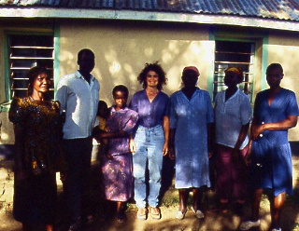
With My Luo Hosts in Western Kenya
With My Luo Hosts

Slide 16
Luo Compound
Private Entrance
1st Wife
3rd Wife
2nd Wife
Husband
4th Wife
Grandmother & Young Children
Unmarried Sons
Main Entrance

Slide 17
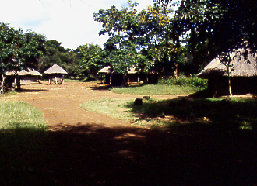
Luo Compound -- Main Entrance

Slide 18
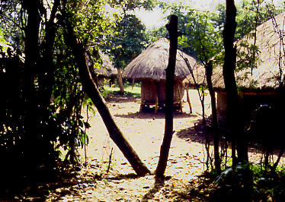
Luo Compound--Private Entrance

Slide 19
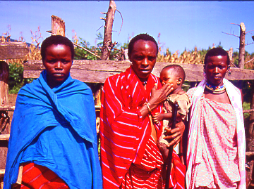
Masaai Polygynous Triad

Slide 20
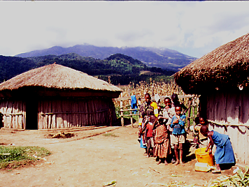
Masaai Compound

Slide 21
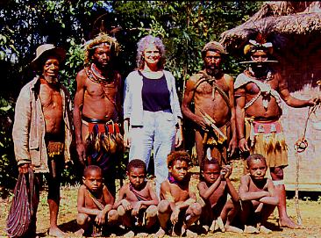
With my Huli Hosts

Slide 22
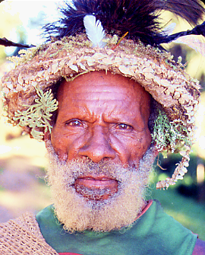
Huli Polygynist

Slide 23
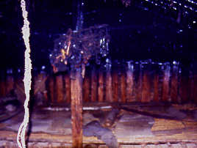
Huli Men’s House

Slide 24
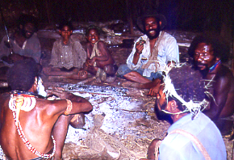
Huli Men

Slide 25
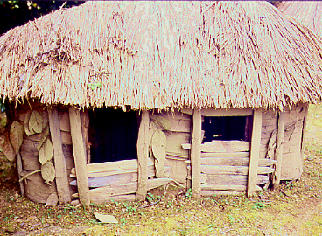
Huli Co-Wives House

Slide 26
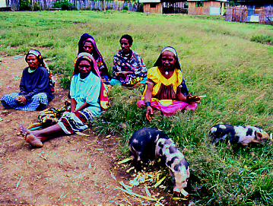
Enga Women with their Pigs

Slide 27
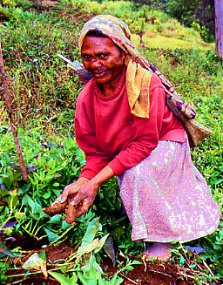
Sweet Potato Garden

Slide 28
Cheating Survey
May 2008 – April 2009 (11 months)
1055 completed surveys (98% completion)
12 Questions
Insight into why people seek extra-relationships sex

Slide 29
Cheating Survey Participants
Males 43%
Females 57%
61% have been cheated on
59% have cheated on a partner
57 % have been a secret lover
72% of those who have cheated
have also been cheated upon

Slide 30
Notes:
While nearly half of our respondents (49%) and the majority of females (59%) contend that there are no acceptable reasons for cheating, males have many sex-seeking reasons to justify cheating. Younger respondents expect more sexually from their marriages than do older ones. Over half of those 24-35 and 61% of those 18-23 do not believe that there are any acceptable reasons to cheat. Over half of males and those 46-55 consider a sexless marriage/relationship to be a reasonable condition for cheating. Over a third of males and those 46-55 (baby boomers) consider the pursuit of sexual activities a partner won’t provide and a spouse’s inability to have sex due to medical reasons to be acceptable reasons to cheat.

Slide 31
Justifications for Cheating
Notes:
What we see here is that those with cheating experience are more likely to espouse justifications for cheating. Combo males’ reasoning is slightly more robust than potential males’ reasoning for conditions under which cheating ought to be acceptable. Likewise combo females’ reasoning is just slightly more affirmative about cheating than that of potential females.

Slide 32
Multiple Partner Survey
March 19 – April 4, 2008 (2 ½ weeks)
716 completed surveys (99.6% completion)
50 Questions

Slide 33
Age
Average – 39
Median – 38
Mode – 38
Range 19-74
Notes:
Children of baby boomers – born near the peak of the sexual revolution (1970s)

Slide 34
Sex

Slide 35
Education

Slide 36
Sexual Orientation

Slide 37
Notes:
74.1% of females bisexual
62.5% of males heterosexual

Slide 38
Notes:
Poly females most likely to consider themselves Kinsey twos while poly males mostly likely to see themselves as Kinsey ones. Meanwhile, swinger males are most likely to claim they are zeros and swinger women equally distribute between ones and twos.

Slide 39
Relationship Patterns
Notes:
In America when one is single and dating it is considered acceptable to have multiple partners as long as one’s ultimate intentions are to pick one single partner (for life).

Slide 40
Residence Patterns

Slide 41
Poly Identity vs. Poly Behavior
Alignment with ideology
  Non-possessiveness
  Transparency
  Consensuality
  Jealousy Management
  Compersion
Multiple Partners/Lovers
  Satisfied with quantity and quality of visits
  Research has shown that poly-identified people do not necessarily have many partners and lots of sex

Slide 42
Number of Partners
Notes:
Lifetime range 0-4,327 (average 64; median 21.5; mode 20)
Last year range 0-200 (average 4.9; median 3; mode 2)
Current range 0-20 (average 2.4; 2 median; 2 mode)

Slide 43
How Being in a
Poly Relationship Feels
High Demand for Honesty
Primary vs. Secondary vs. Incidental
  The challenges of having multiple primaries
    Logistics, Communication, Respect
  The challenges of not feeling like anyone’s primary
    The importance of being a favorite
  The possibility of having multiple statuses
    Being an NRE enhanced favorite and a public primary
Consideration: Is it possible to be happy with polyamory and to not feel like a favorite and/or have a primary status?

